Slide 1

Notes on Bullshit
Dr. Greg Erhardt
greg.erhardt@uky.edu CE599-002

Slide 2
Sources
The thoughts presented here are drawn primarily from the sources below. I attempt to synthesize and add my own thoughts.
INFO 270 Calling Bullshit: Data Reasoning in a Digital World Carl T. Bergstrom and Jevin West, University of Washington:
https://callingbullshit.org/syllabus.html
Harry Frankfurt (1986) On Bullshit. Raritan Quarterly Review 6(2)
G. A. Cohen (2002) Deeper into Bullshit. Buss and Overton, eds., Contours of Agency: Themes from the Philosophy of Harry Frankfurt Cambridge, Massachusetts: MIT Press.

Slide 3

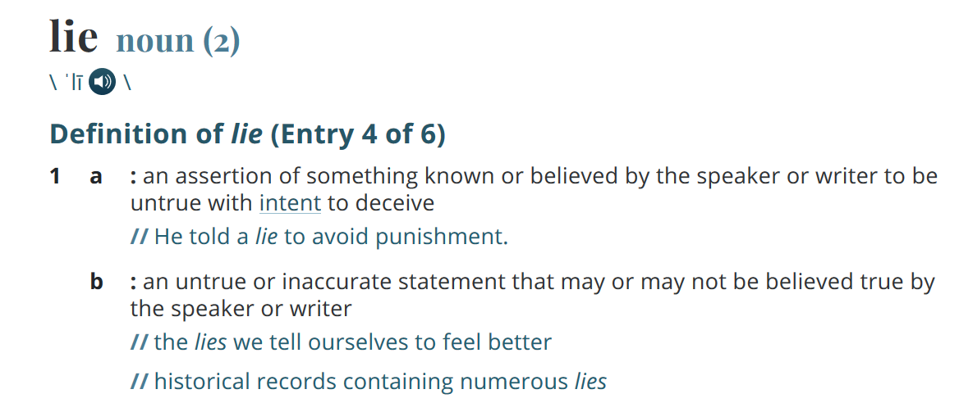

Slide 4
The liar is inescapably concerned with truth-values. In
order to invent a lie at all, he must think he knows what is true. And in order to invent an effective lie, he must design his falsehood under the guidance of that truth.
Harry Frankfurt (1986) On Bullshit. Raritan Quarterly Review 6(2)

Slide 5
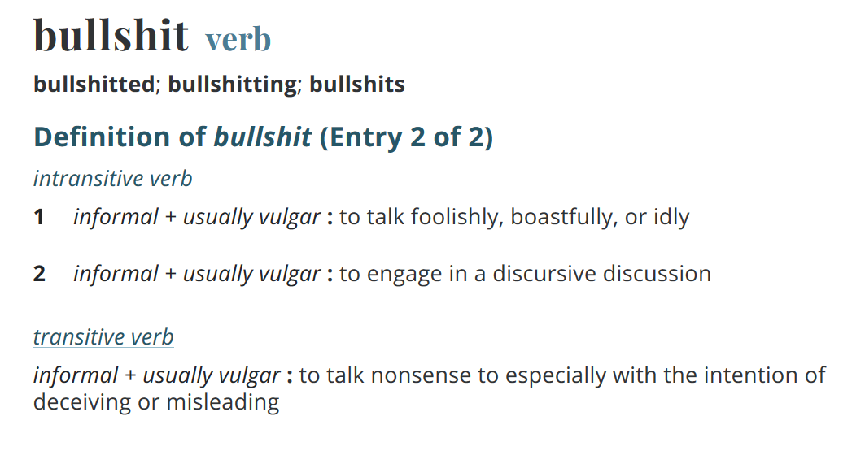

Slide 6
That is why she cannot be regarded as lying; for
she does not presume that she knows the truth, and therefore she cannot be deliberately promulgating a proposition that she presumes to be false: Her statement is grounded neither in a belief that it is true nor, as a lie must be, in a belief that it is not true. It is just this lack of connection to a concern with truth — this indifference to how things really are — that I regard as of the essence of bullshit.
Harry Frankfurt (1986) On Bullshit. Raritan Quarterly Review 6(2)

Slide 7
Lying and bluffing are both modes of misrepresentation or deception. Now the concept most central to the distinctive nature of a lie is that of falsity: the liar is essentially someone who deliberately promulgates a falsehood. Bluffing too is typically devoted to conveying something false. Unlike plain lying, however, it is more especially a matter not of falsity but of fakery... This points to a similar and fundamental aspect of the essential nature of bullshit: although it is produced without concern with the truth, it need not be false.
Harry Frankfurt (1986) On Bullshit. Raritan Quarterly Review 6(2)

Slide 8
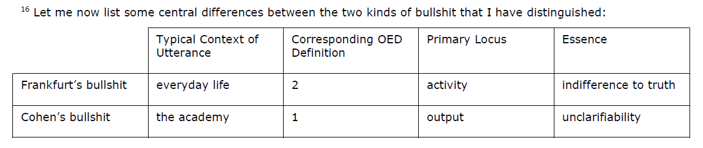
My bullshit belongs to the category of statement or text. It is
not primarily an activity but the result of an activity…But what particularly interests me is a certain variety of nonsense, namely, that which is found in discourse that is by its nature unclarifiable, discourse, that is, that is not only obscure but which cannot be rendered unobscure.
G. A. Cohen (2002) Deeper into Bullshit. Buss and Overton, eds., Contours of Agency: Themes from the Philosophy of Harry Frankfurt Cambridge, Massachusetts: MIT Press.

Slide 9
Implications
1. Truth is the wrong metric for BS.
You cannot identify BS using the truth of a statement. Instead you must look at clarity or at concern for the truth.
You cannot effectively argue with a bullshitter on the basis of what is true or untrue. Instead you must push them to clarify what they are saying and reject what is not clear.

Slide 10
Implications
2. Bullshitters often aim to distract, rather than deceive.
A bullshitter caught in a lie will often change the subject, rather than continue to debate the lie. This often manifests as “What about…” or as anger.
The key question then becomes relevance, not truth. If you let a bullshitter set the topic of debate, they start with a huge advantage.

Slide 11
Implications
3. BS is arguably more damaging than lies because it suggests that the truth does not matter, or perhaps that there is no objective truth.
In this way, it often serves to discredit the bullshitter’s opponent. Even if one does not believe the bullshitter, they may cast enough doubt on everything that one doesn’t believe their opponent either.
Centrism bias makes this worse. The truth is not necessarily somewhere in between both sides.

Slide 12
Implications
3. BS is arguably more damaging than lies because it suggests that the truth does not matter, or perhaps that there is no objective truth.
This will often show up as finding an inaccuracy in a generally credible source and using that one example to discredit it entirely. Such errors are not ok and should be transparent, but are often presented as equivalent to a wealth of deception on the part of the bullshitter.
We are taught to be skeptical, and this is often good. But skepticism can make matters worse if it leads to us dis-believing credible but imperfect sources. Taken to the extreme it can lead to cynicism.

Slide 13
Implications & Notes
4. BS is both about a product and a person.
You can evaluate a statement for lies and separately evaluate it for BS. However, if someone has proven themselves to be acting in bad faith, you should not continue to take their statements seriously.
(Note that there is some debate about this issue, but I am fully behind this advice.)

Slide 14
Summary of Advice
Reality matters! The truth matters!
Distinguishing between lies and bullshit is a core skill for the modern era.
Focus on relevance.
Push for clarity.
Be skeptical but not cynical.
Choose your company wisely.

